Slide 1
WFC Stock Market Impact Analysis
Regis University – MSDS692 s40 - Data Science Practicum I
Instructor: Mike Busch
Lizbeth Bolano

Slide 2
Objective
Analyze how the fake accounts scandal in 2016 affected Wells Fargo's stock price and market position during the period from 1996 to 2022.

Slide 3
Methods
Comparative Analysis: Compare WFC’s stock performance to competitors like JPMorgan Chase and Bank of America.
Time Series Analysis: Analyze Wells Fargo's (WFC), JPMorgan Chase and Bank of America stock price before, during, and after the scandal using Prophet.

Slide 4
Stock Data:
Kaggle: WELLS FARGO Stock Data
BAC.com: BAC Stock Data
Investing.com: JPM Stock Data

Slide 5

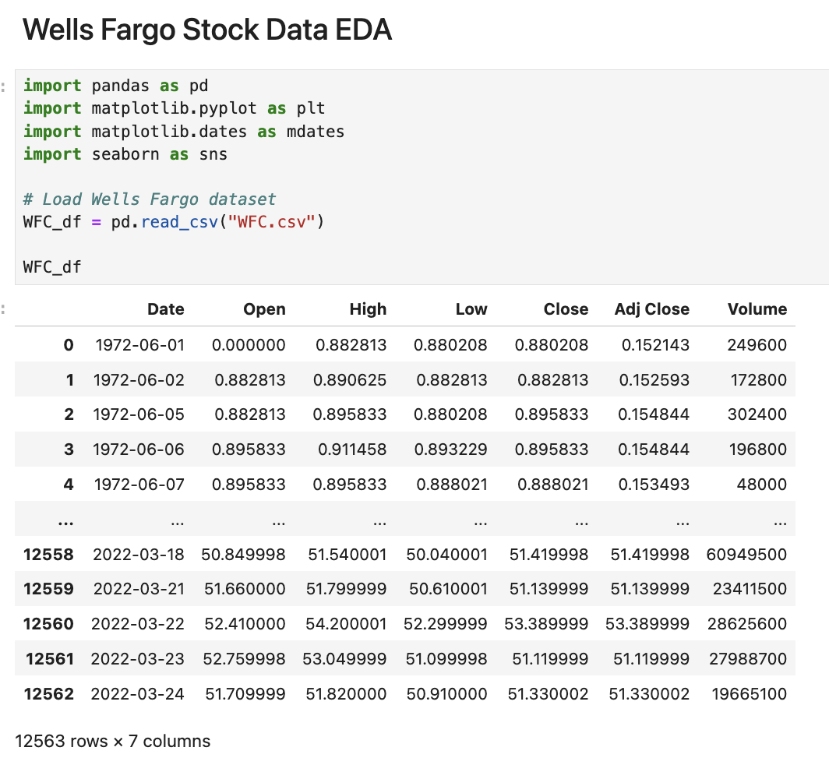
Notes:
Data Fields:
Date: Date of the transaction
Open: Price from the first transaction of a trading day
High: Maximum price in a trading day
Low: Minimum price in a trading day
Close: Price from the last transaction of a trading day
Adj Close: Closing price adjusted to reflect the value after accounting for corporate actions
Volume: Number of units traded in a day

Slide 6
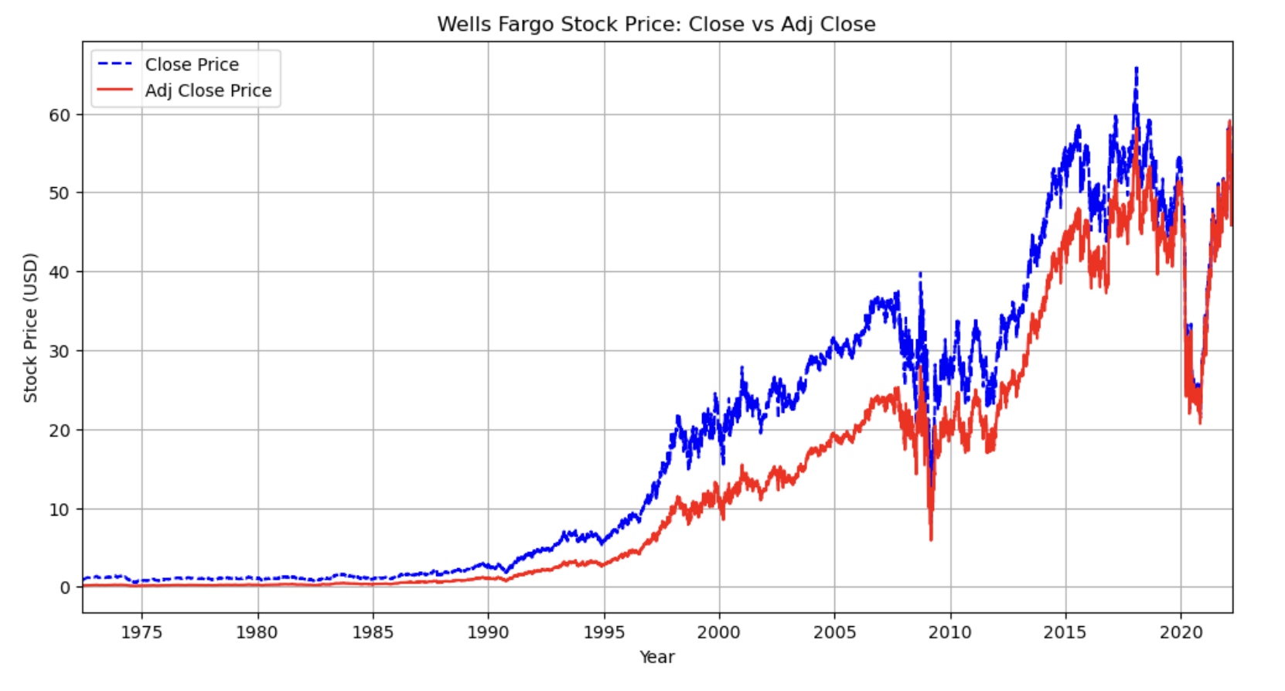
Notes:
Pre-2007: A general upward trend with periodic fluctuations.
2007-2012: A more linear movement, where the stock price remained relatively stable with some volatility, likely influenced by the 2008 financial crisis.
2012-2016: A sharp increase, suggesting strong investor confidence before the scandal became public.
2016 Drop: A notable decline in stock value, reflecting the market’s reaction to the scandal.
Post-2016 Recovery: Despite the scandal, the stock price rebounded, indicating Wells Fargo’s ability to regain investor trust over time.

Slide 7
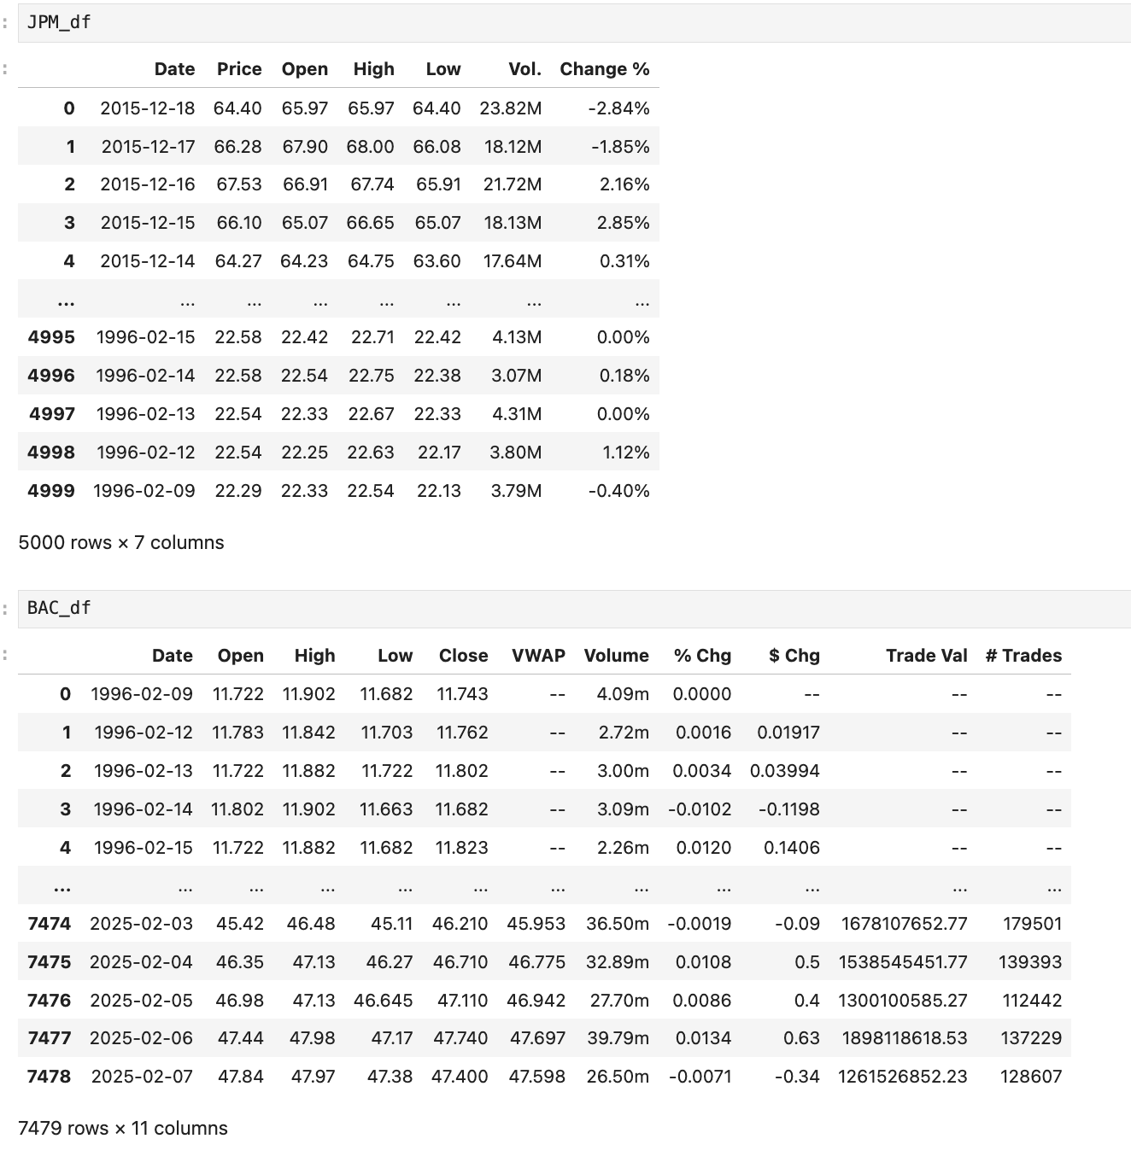
Comparison of WFC Stock Price Trends Against JPMorgan Chase & Bank of America

Slide 8
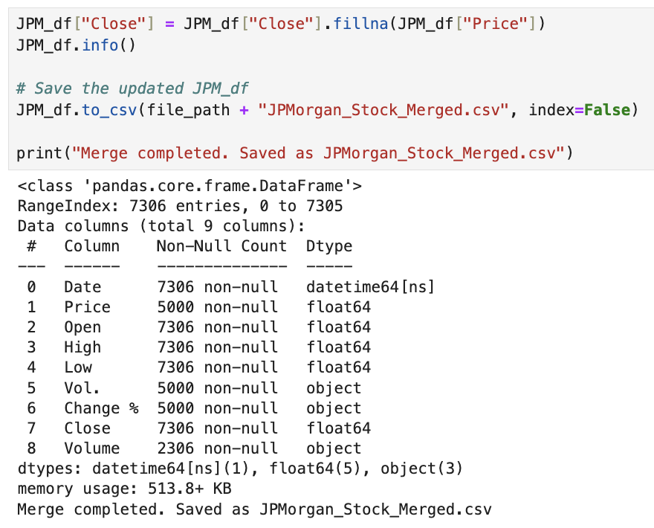
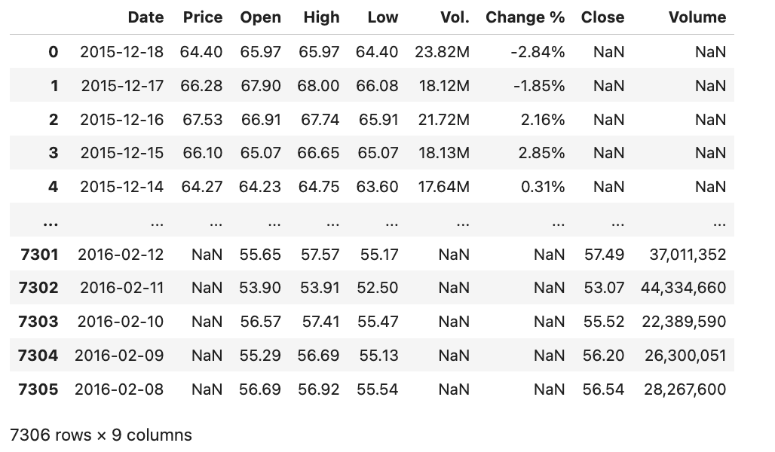

Slide 9
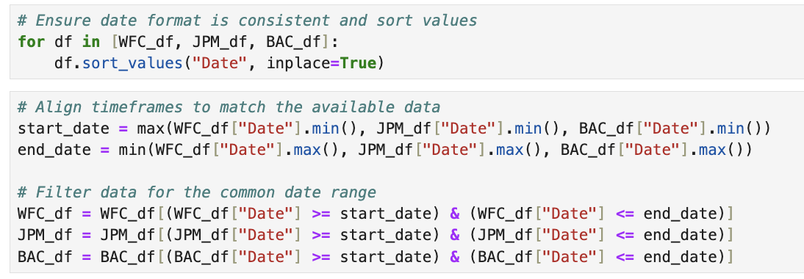
Align timeframes to match the available data
Notes:
Start Date:
The max() function takes the latest (largest) of these minimum dates.
This ensures that all three DataFrames have data from that date onward.
End Date:
The min() function picks the earliest (smallest) of these maximum dates.
This ensures that all three DataFrames have data up to that date.

Slide 10
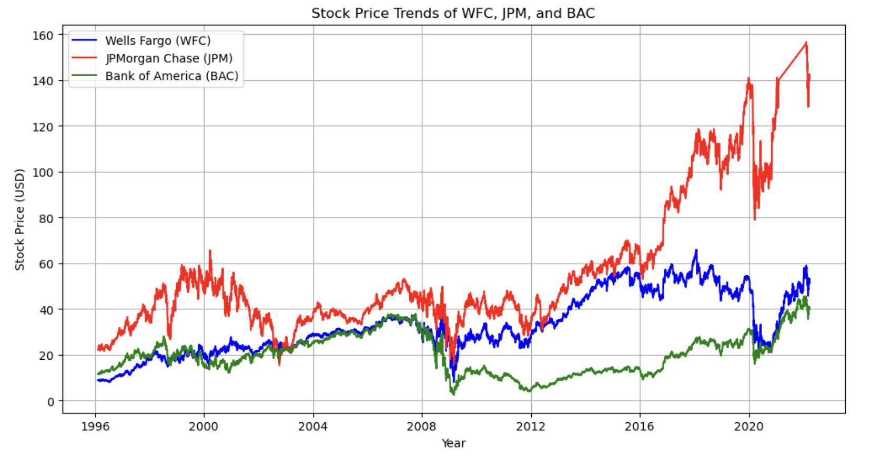
Notes:
After the 2016 Wells Fargo scandal, all three banks saw stock drops but recovered differently.
JPMorgan Chase (red) rebounded quickly, continuing an upward trend, showing strong investor confidence.
Bank of America (green) recovered more slowly but eventually climbed.
Wells Fargo (blue) struggled the most, staying flat for a while before modest growth, impacted by fines, leadership changes, and reputational damage.
JPM recovered the fastest, while WFC had the hardest time regaining trust.

Slide 11
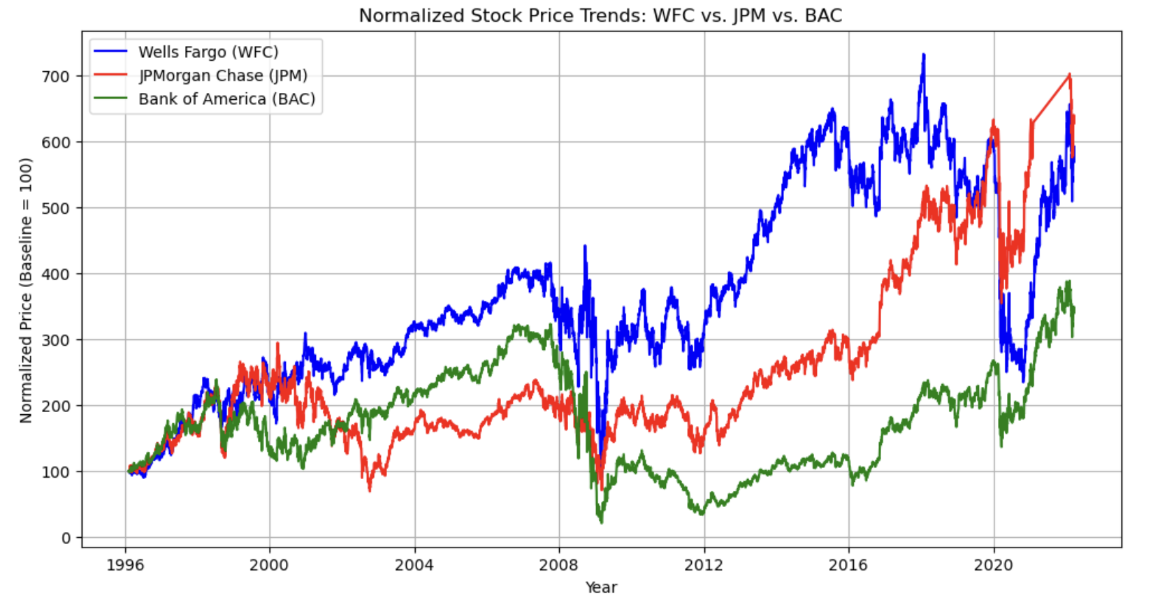
Normalize Prices for Comparison
Notes:
This ensures that all stocks start at the same level, making trends easier to compare.
1990s - Early 2000s: All three banks had a generally upward trend, with WFC (blue) leading most of the time.
2008 Financial Crisis: All three banks experienced a sharp drop, with BAC (green) declining the most.
Post-2008 Recovery: WFC bounced back strongly and led the growth, while JPM and BAC recovered more slowly.
Wells Fargo Scandal (2016): After 2016, WFC's stock performance weakened, showing more fluctuations compared to JPM and BAC.
Recent Trends: JPM (red) has surged the most, WFC remains volatile, and BAC is growing but at a slower pace.

Slide 12

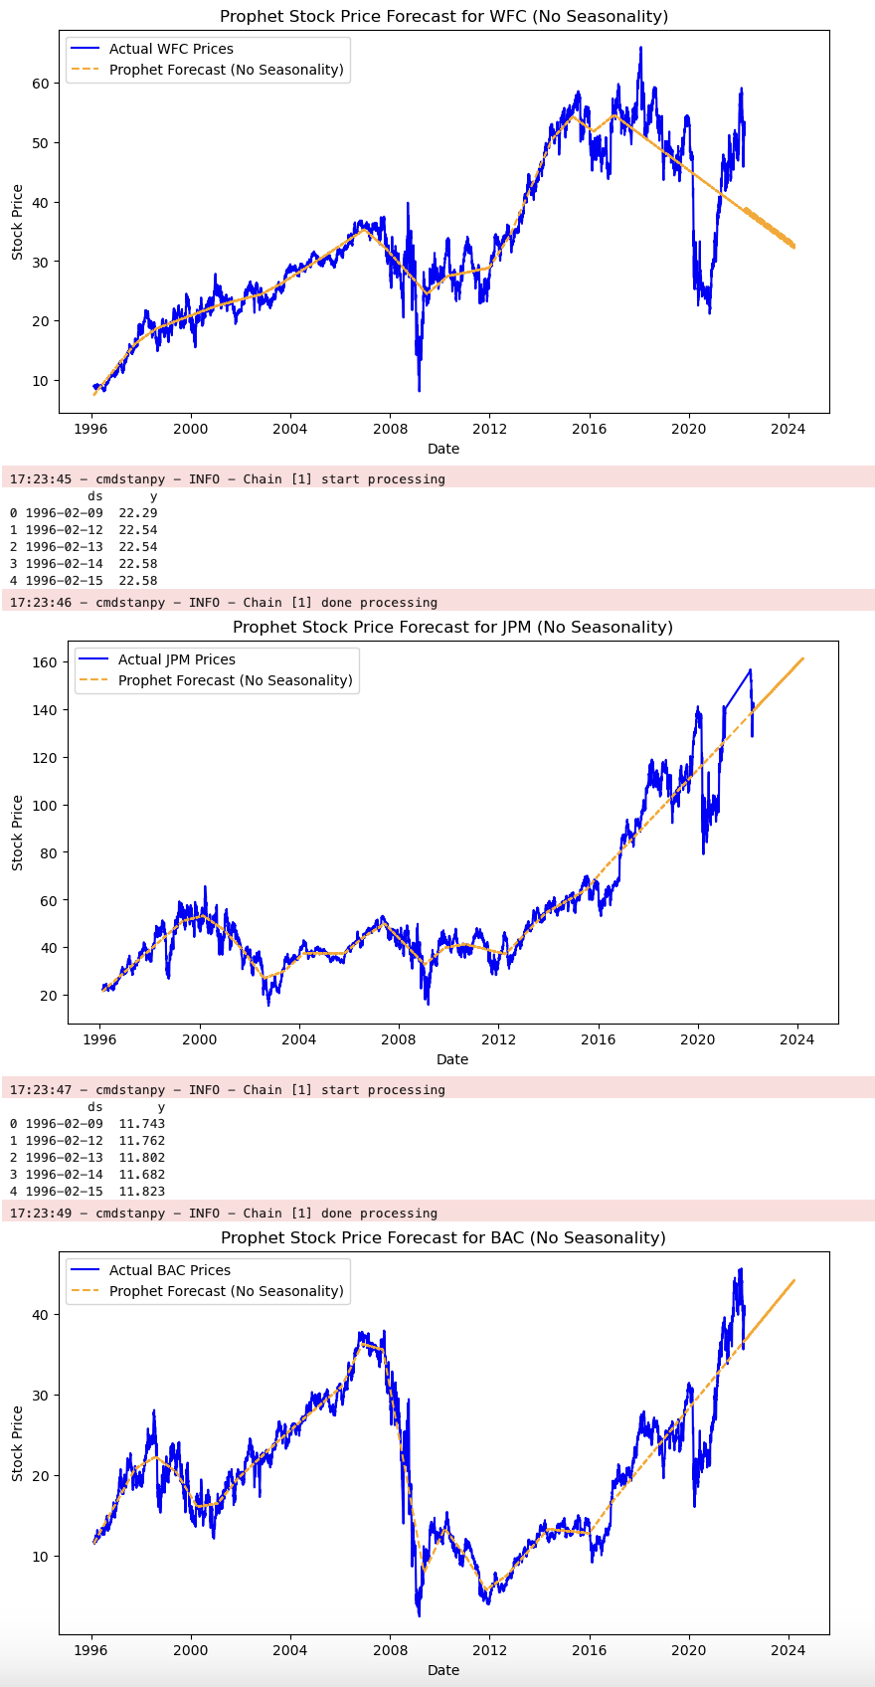
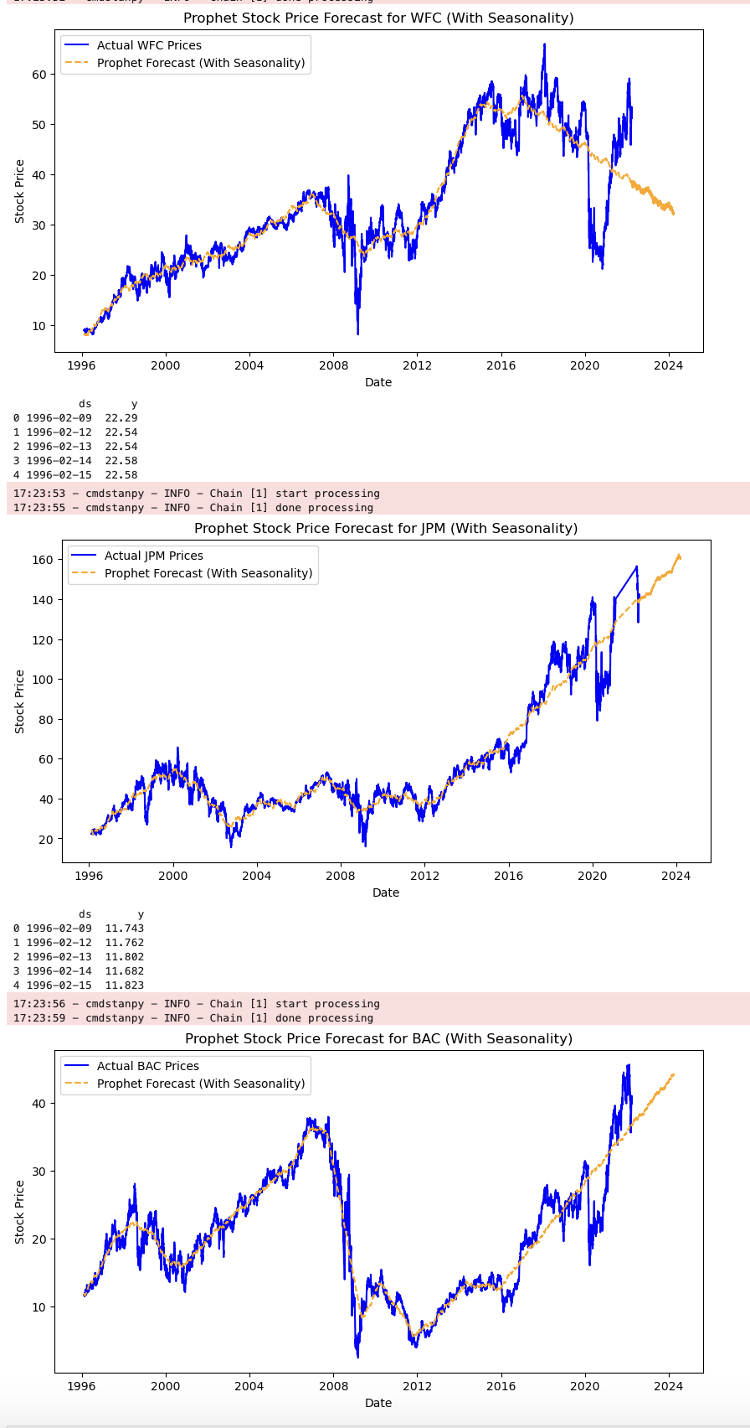
Time series analysis
Notes:
Prophet (to capture trends & seasonality)
This method is well-suited for long-term forecasting, making it a strong choice for this 26-year dataset.
General Trend Comparison:
The forecasts without seasonality (first set of images) show a smoother long-term trend, mostly driven by overall stock price movements.
The forecasts with seasonality (second set of images) capture additional fluctuations that may be due to recurring patterns, such as economic cycles or quarterly trends.
Stock-Specific Insights:
WFC (Wells Fargo & Co.): The no-seasonality model predicts a continued decline. The seasonal model also suggests a decline but incorporates fluctuations, possibly indicating cyclical downturns and recoveries.
JPM (JPMorgan Chase & Co.): Both models predict continued growth, but the seasonal model introduces more variation, reflecting past fluctuations.
BAC (Bank of America): The no-seasonality model predicts steady growth. The seasonal model also predicts growth but with additional variation that follows past cyclical patterns.
Impact of Seasonality on Forecasts:
The seasonal models generally capture historical fluctuations more accurately, leading to slightly different future predictions. The no-seasonality models assume a more linear trend, which might not fully reflect the real-world influences on stock prices.
[59]:

Slide 13
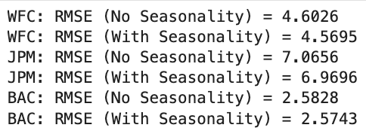
Compare Errors Using RMSE
To see which model is more accurate, I will calculate the Root Mean Squared Error (RMSE) for both models. A lower RMSE means the forecast is more accurate.
Notes:
As we can see, the results show that the RMSE values for the forecasts with seasonality are slightly lower than those without seasonality for all three stocks. This suggests that incorporating seasonality into the Prophet model slightly improved the forecasting accuracy.

Slide 14
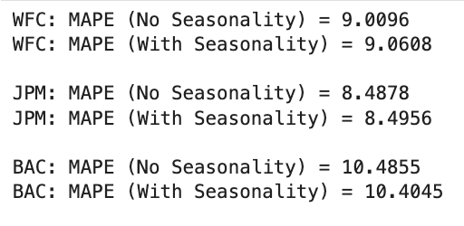
Compare Mean Absolute Percentage Error (MAPE)
MAPE gives a percentage-based error measure:
The lower the MAPE, the better the model performs.
Notes:
Wells Fargo and JPM saw a slight increase in MAPE with seasonality, meaning forecasts became marginally less accurate in percentage terms.
BAC saw a slight improvement (10.4855 → 10.4045), but the change is minimal.

Slide 15
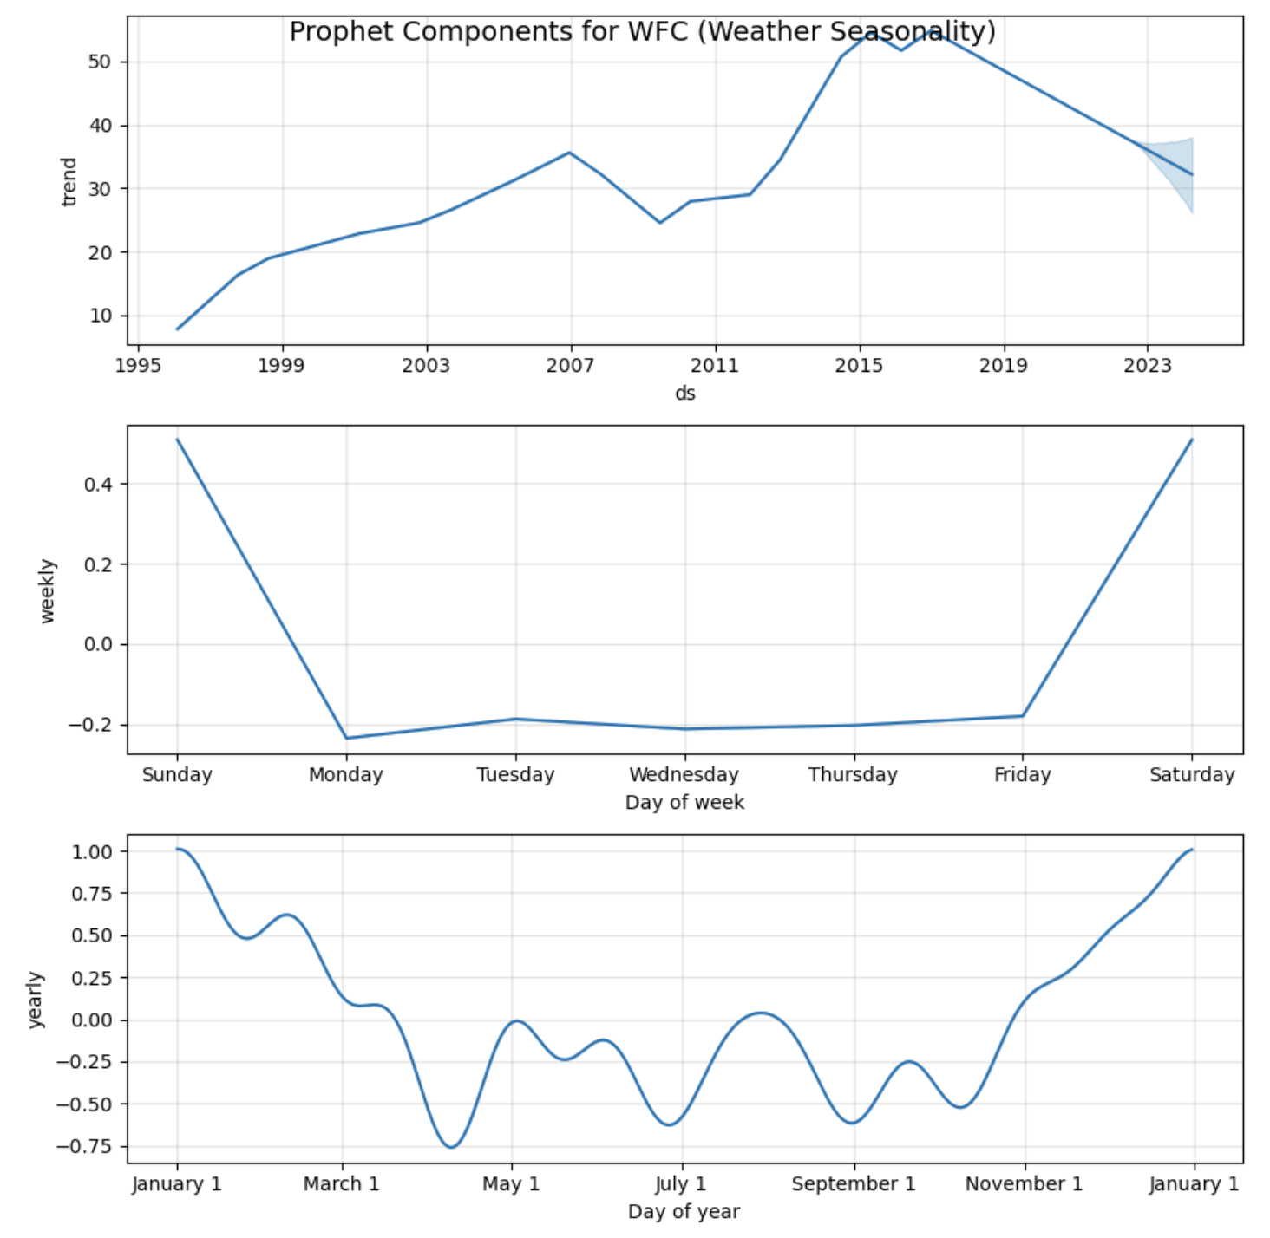
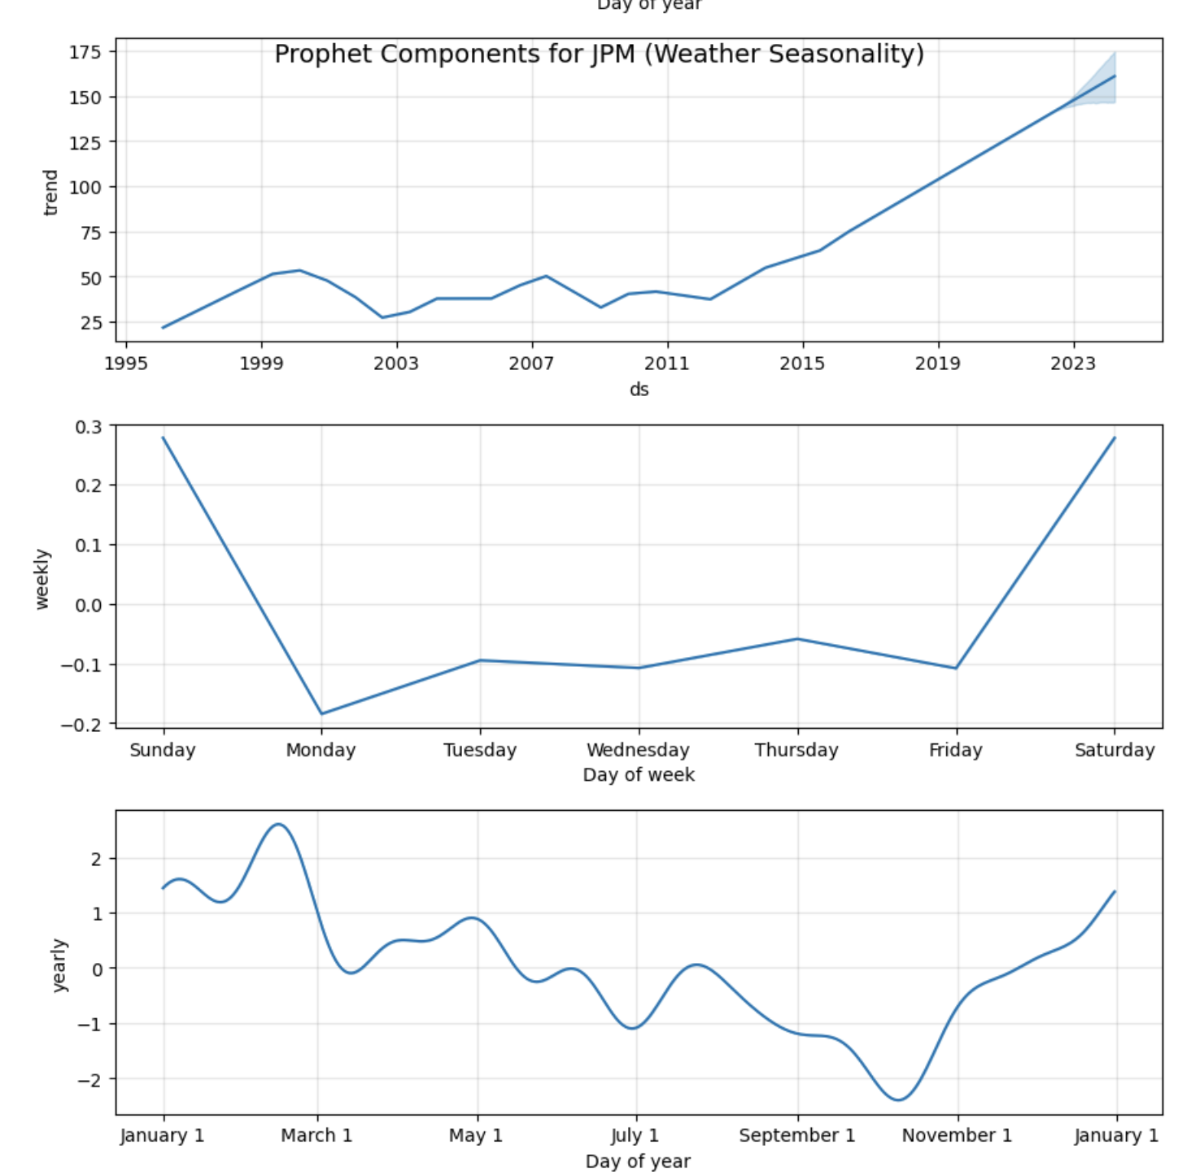
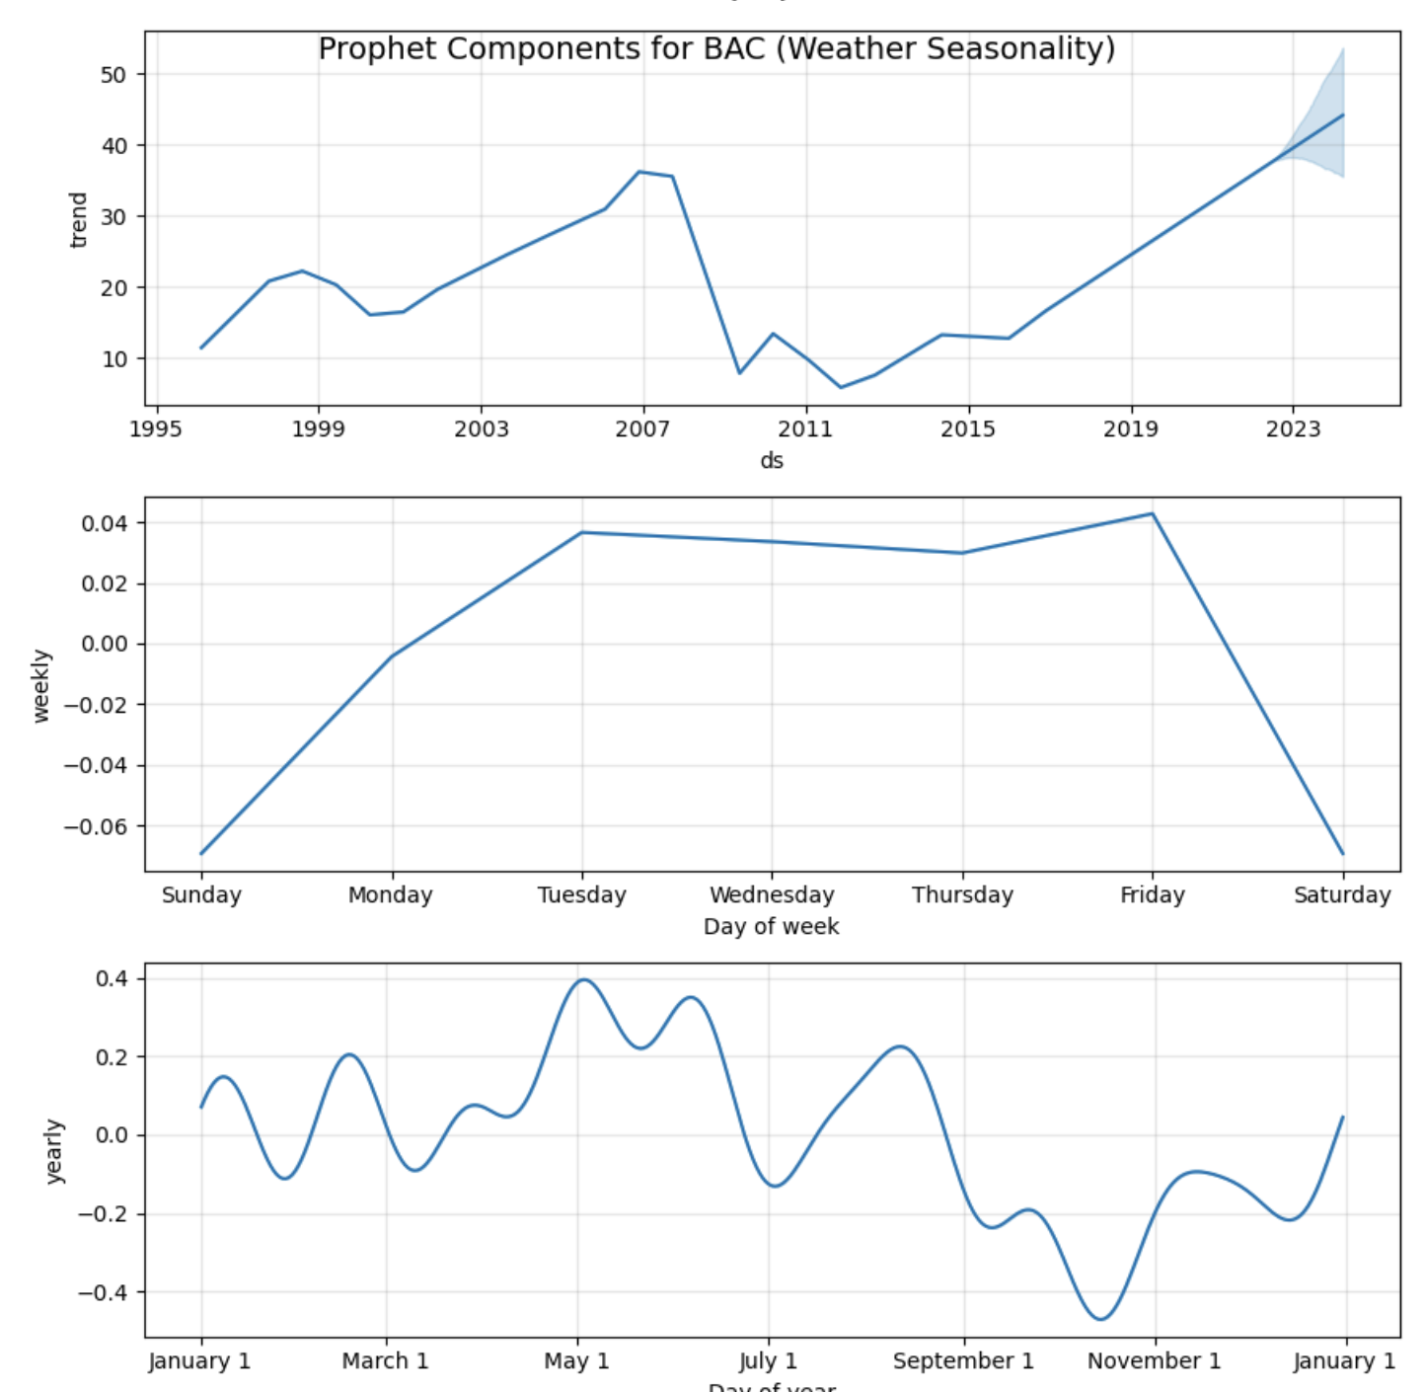
Notes:
WFC
Trend Component: The stock price has generally increased since 1995, peaking between 2015-2019, followed by a decline. The uncertainty band suggests higher volatility in future predictions. - Weekly Seasonality: Stock activity dips from Monday to Thursday, with a small recovery on Friday and a sharp increase over the weekend (Saturday and Sunday). - Yearly Seasonality: The stock shows multiple peaks and dips throughout the year, with a rise in January, a dip from March to May, fluctuations in July and September, and an uptrend towards the end of the year.
JPM
- Trend Component: JPM's stock has shown a steady increase over time, with significant acceleration after 2015. The upward trend is steeper than WFC's, and the uncertainty band indicates continued growth.
Weekly Seasonality: Similar to WFC, JPM experiences the highest increase on Sunday, followed by a drop on Monday. Tuesday to Friday shows little variation, with a small rebound on Saturday, reflecting typical market adjustments after weekends.
Yearly Seasonality: JPM’s yearly trend mirrors WFC’s, with a peak in January-February, a dip from March to May, fluctuations in June-September, and a strong drop in October-November before recovering in December. These patterns are likely influenced by market cycles, earnings reports, and macroeconomic factors.
BAC
Trend Component:
1995-2007: Strong growth, peaking around 2007 before a sharp decline.
2008-2013: Significant drop due to the 2008 financial crisis, followed by stagnation.
2013-2023: Strong recovery with accelerating growth after 2019.
Weekly Seasonality: The pattern is less volatile than WFC and JPM, with a drop on Sunday followed by steady growth from Monday to Friday. Unlike WFC and JPM, Tuesday sees the highest increase, while Saturday experiences a sharp decline.
Yearly Seasonality:
January-March: Moderate fluctuations.
April-May: Strong seasonal peaks.
June-September: Smaller fluctuations, but remains positive.
October-November: Clear drop, followed by recovery in December.

Slide 16
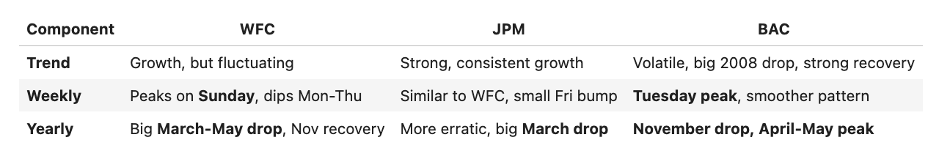
Notes:
In summary:
JPM has the most stable long-term growth.
BAC has the most volatility but has rebounded strongly.
WFC has seasonal patterns similar to JPM but fluctuates more.

Slide 17
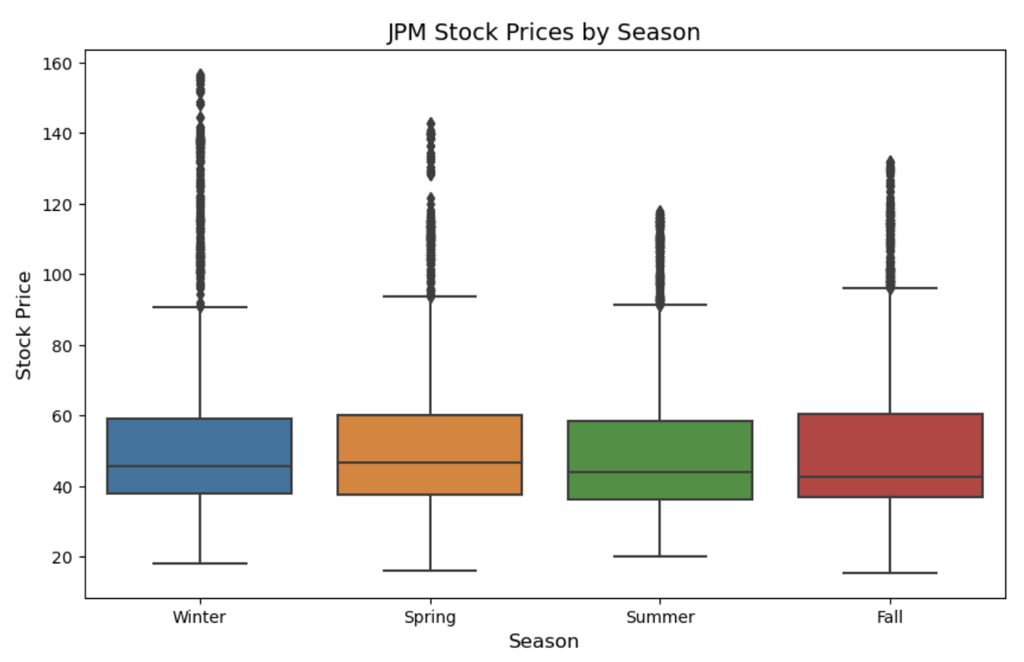
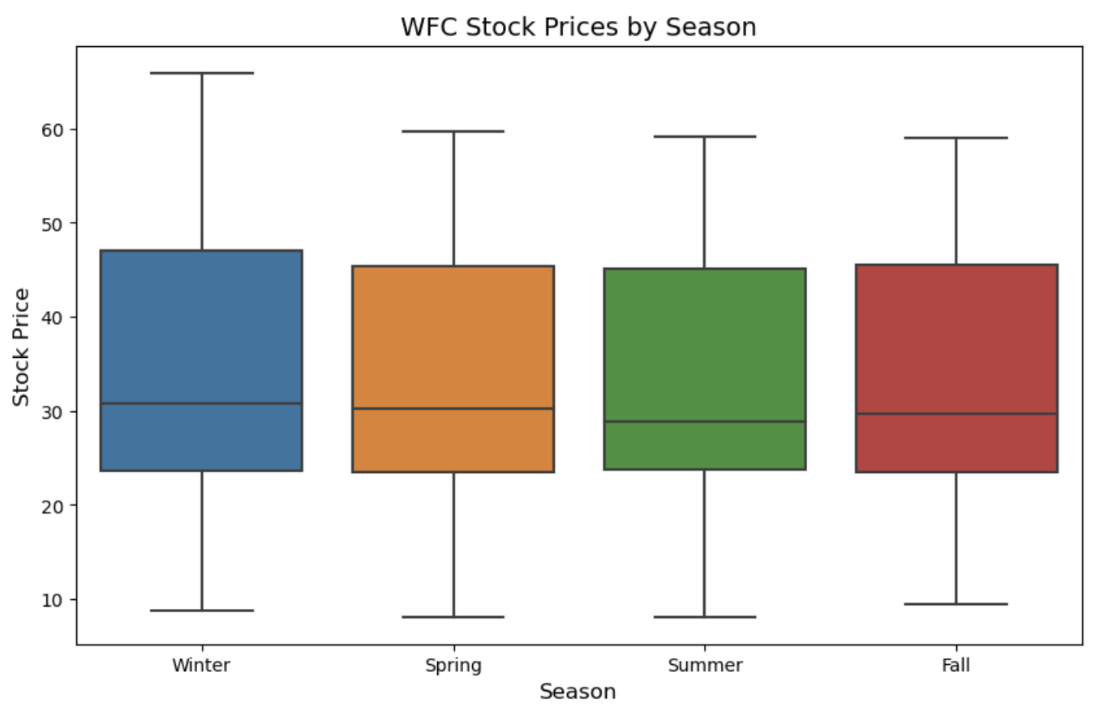
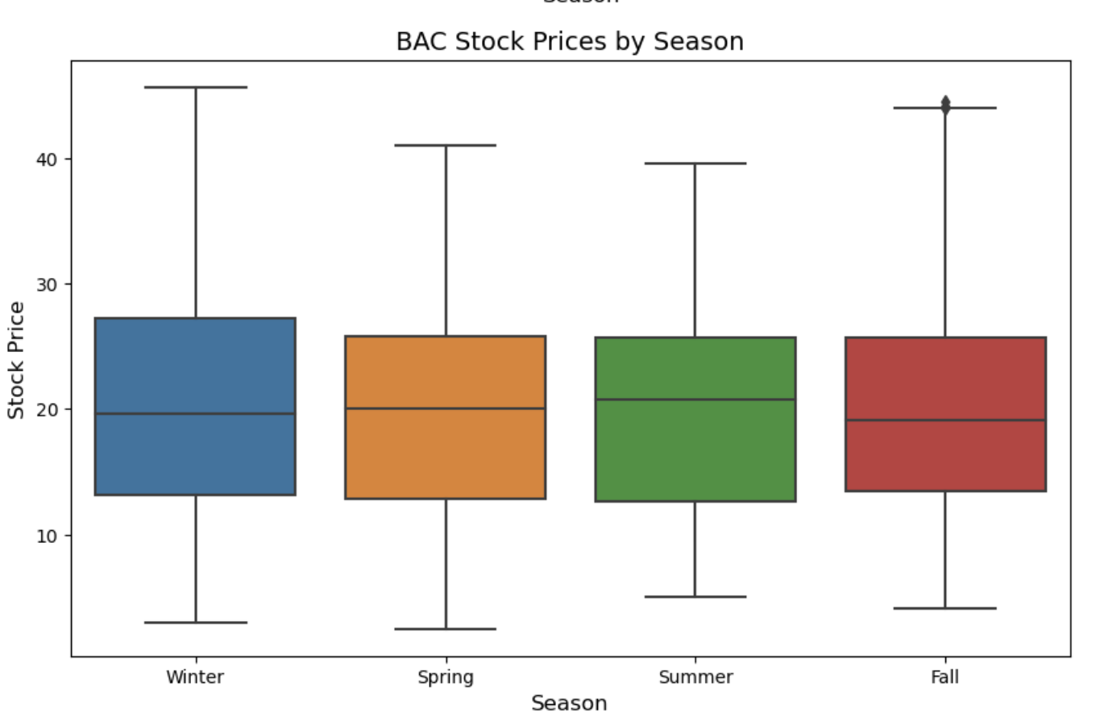
Notes:
WFC: The stock price remains stable throughout the year, with little seasonal impact. The median stays consistent, and the price range doesn’t change much. A few lower-end outliers are present, but they are not extreme.
JPM: While the median price is stable, JPM shows more volatility with numerous upper outliers, especially beyond $100, indicating larger price fluctuations compared to WFC and BAC. The spread is wider, signaling more price volatility throughout the year.
BAC: Similar to WFC, BAC shows stable stock prices across all seasons, with a consistent median and range. There are some high outliers, but nothing as extreme as JPM’s fluctuations.
Overall, WFC and BAC stocks are stable, while JPM experiences more volatility. However, none of the stocks show a strong seasonal pattern, suggesting that stock prices aren’t significantly influenced by the time of year. Further analysis could be done to confirm this, but seasonality doesn’t appear to be a major factor based on these visuals.

Slide 18
Key Takeaways:
JPM was the most resilient post-scandal, maintaining strong investor trust.
WFC faced the hardest hit and showed inconsistent recovery.
BAC followed a moderate recovery path.
Seasonality had minimal impact on stock prices.

Slide 19
THANKS, GRACIAS!

